Slide 1


Python programming
Logic

Slide 2
If and Else
Conditional branching
value = input()
if value is 'BYE':
print('Goodbye!')
exit()
Notes:
We've seen the if statement before, in this example.
2

Slide 3
If and Else
else
value = input('Your name, or bye')
if value is 'BYE':
print('Goodbye!')
exit()
else:
print('Hello', value)
Notes:
We also have the option of adding an else statement which does not include a conditional test as it applies whenever the if test is untrue.
But what if our user doesn’t follow our instructions and instead types quit? At the moment our program will print “Hello quit”.
3

Slide 4
If and Else
else if else
if value is 'BYE':
print('Goodbye!')
else:
if value is 'QUIT':
print('Goodbye!')
exit()
else:
print('Hello', value)
Notes:
Here is the solution using if and else statements, but it turns out this kind of test is so common that Python provides an extra keyword.
4

Slide 5
If and Else
if elif else
if value is 'BYE':
print('Goodbye!')
exit()
elif value is 'QUIT':
print('Goodbye!')
exit()
else:
print('Hello', value)
Notes:
Using the elif keyword the program is easier to read. Note that this does exactly the same thing, these two programs are equivalent.
However the program has what some might consider a design flaw. There are two lines of the program that do exactly the same thing – programmers don’t like this as it can cause mistakes to be made.
5

Slide 6
Logic
in
if value in ['BYE','QUIT']:
print('Goodbye!')
exit()
else:
print('Hello', value)
The in keyword tests if the value of the variable is found in the list.
Notes:
Here the program is rewritten to make use of the in test. Now the if test checks if the variable is set to either BYE or QUIT.
6

Slide 7
Logic
Conditional expressions
A is B
A is not B
A in [B]
A not in [B]
not A
A and B
A or B
A == B
A != B
A > B
A < B
A <= B
A >= B
Notes:
Python tries hard to give an English language like syntax to conditional expressions. So we have these logical operators.
When dealing with numbers we have familiar mathematical expressions such as less than and greater than.
7

Slide 8
Logic
Boolean algebra
# Values True False
# Operators or and not
# Boolean arithmetic, e.g.
not (a and b)
# is equivalent to
(not a) or (not b)
Notes:
For a lot of programming problems an if-else test is sufficient, but if you find yourself nesting if tests or placing multiple it tests inside a while loop then most likely what you really need is some boolean algebra. Named after George Boole a 19th century school teacher who developed a system of arithmetic with two possible values, True and False, and three operators OR, AND, and NOT.
8

Slide 9
Logic
Truth tables
a b a and b not (a and b)
-------------------------------
0 0 0 1
0 1 0 1
1 0 0 1
1 1 1 0
Notes:
Here I’ve chosen to represent False as zero and True as one. You can also use these values rather than True and False in your Python programs. Be aware though that although Python considers 0 and False to be equivalent this is not the case with 1 and True, Python actually treats any non-zero value as True.
9

Slide 10
Logic
Untrue!
if False or 0 or None or "" or [] or {}:
# Nothing to do
else:
print("They're all untrue!")
Notes:
Here I’ve chosen to represent False as zero and True as one. You can also use these values rather than True and False in your Python programs. Be aware though that although Python considers 0 and False to be equivalent this is not the case with 1 and True, Python actually treats any non-zero value as True.
10

Slide 11
Binary arithmetic
Add or subtract two numbers in binary
number 8 4 2 1
5 0 1 0 1
+ 4 0 1 0 0
= 1 0 0 1
number 8 4 2 1
5 0 1 0 1
~4 1 0 1 1
= 0 0 0 0
+1 0 0 0 1
= 0 0 0 1
Notes:
Now is as good a time as ever to discuss binary arithmetic. It’s often said that computers just work with ones and zeros, or bits and bytes. So why haven’t we discussed this so far? Well Python, and other programming languages, do a good job of hiding this from us. And with good reason, because although humans are pretty good at Boolean logic, working with lots of ones and zeros is hard.
11

Slide 12
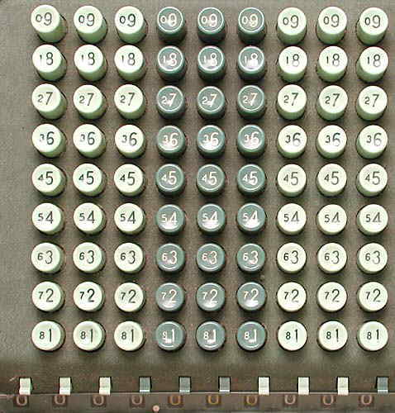
Mechanical “computers”
Comptometers, used for accounting had keyboards that showed the compliment of each number.
To subtract 2, add 7.
Then an extra 1 in the rightmost column.
Notes:
Bookkeepers have used complementary numbers for centuries and early mechanical computers took advantage of them to simplify the design of the machine, all it needed to do is add.
12

